Slide 1
Tea & Tidbits: Engaging outreach opportunities
SCLA Conference
Presenters: Susan Moore, MLIS & Janet Ward, MLIS

Slide 2
Learning objectives
Analyze resources available
Identify your audience
Plan engaging sessions
Determine inexpensive materials

Slide 3
WELCOME!
Let’s get to know each other!

Slide 4
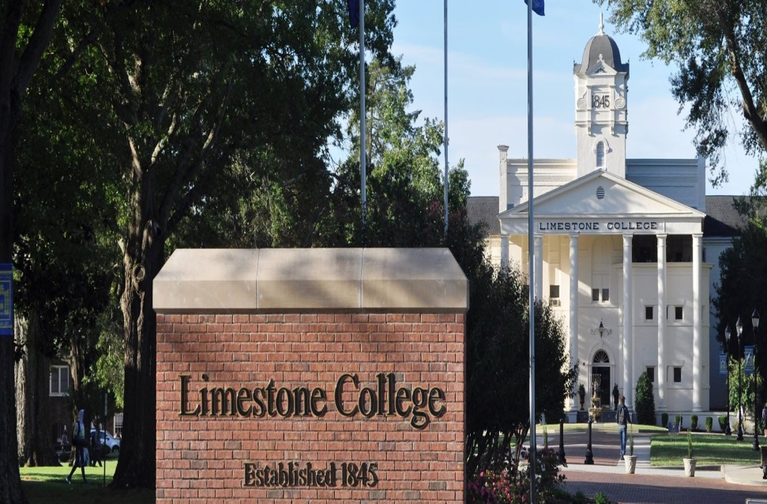
Enrollment
Limestone College enrolls more than 1,000 traditional day students and approximately 2,500 Extended Campus students at eight sites in South Carolina and on the Internet.
Limestone employs 86 full-time faculty

Slide 5
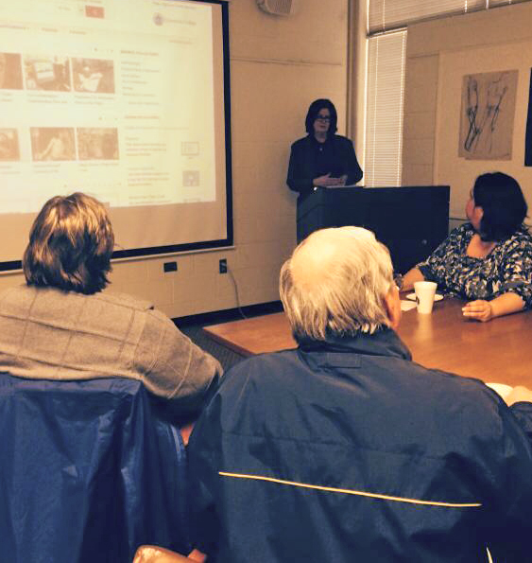
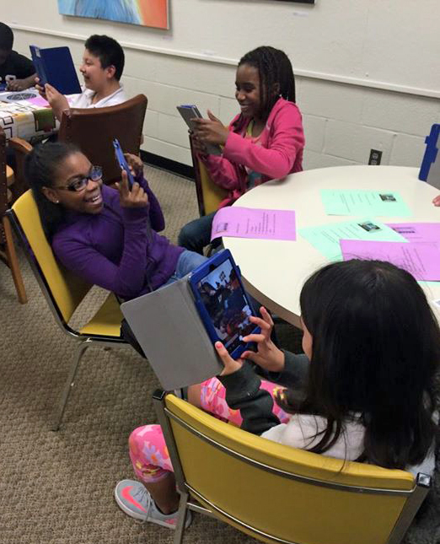
Outreach Programs
Tea & Tidbits
iPad Workshop

Slide 6
Tea & Tidbits
Targeted toward Faculty
Teach new skills
Introduce innovative technology
Deliver practical topics
Demonstrate how to implement Library resources in the classroom

Slide 7
Purpose
To nurture the relationship between faculty and the library
To convey new skills, and to reinforce techniques previously taught
To assist faculty with integrating resources in their instruction
To promote new interfaces, library databases and technology
To reach the students with library resources by way of their instructors

Slide 8
Tea & Tidbits
How we promote:
Announcements in monthly faculty and division meetings
Email
Flyers
Word of mouth

Slide 9
Sample Topics
Persistent Links to resources
Embedding media in Blackboard
E-book usage
Apple TV technology
Library Guides & Instruction
Embedded Librarians
YouTube channel
Webinars and Customized videos

Slide 10
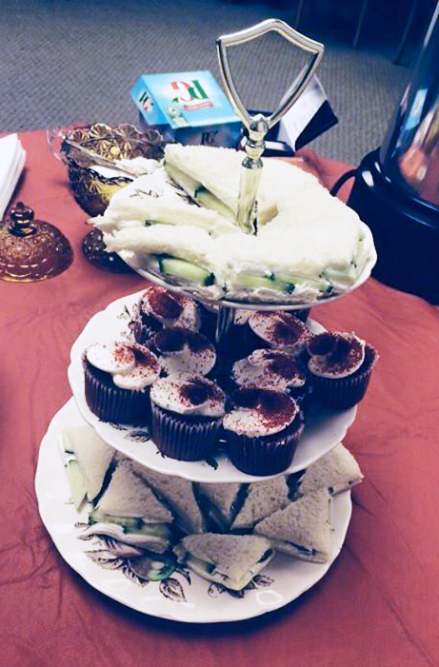
Planning & Expenses
Planning sessions are informal discussions in the office, or emails between presenting librarians
Minimal time is spent planning
Expenses are limited:
Faculty are asked to bring their own cup and favorite tea
Library provides hot water, sugar cubes, napkins and light snacks

Slide 11
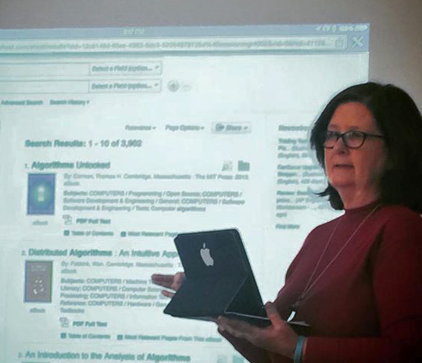
Challenges
Attendance
Scheduling
Limited presentation time
Adjusting to differences in Faculty proficiency

Slide 12
Feedback from faculty
Date | Did you find this training session helpful? | What did you find most helpful? | Are there any other topics you would like to see covered in these sessions? | Other Comments:
Jan/Feb 2014 | Y | The connection between the films on demand sections and the new online classes we are developing. | Interactive Classrooms | Love it!
Jan/Feb 2014 | Y | Shows analogy to "moving to desktop" (in this case; a student's, not yours)
Jan/Feb 2014 | Y | Practical topics - ability to ask questions and get immediate specific help | Handling materials from textbook publishers (and coordinating with other resources) | Great Job!
Jan/Feb 2014 | Y | Learning how to navigate the library site on LC's main webpage (from home) (Pressing "C" or "L")
Jan/Feb 2014 | Y | Knowing that the library has a very informative YouTube account that I can embed in Blackboard | A session on how we can work with the library to create resources and what classroom sessions are available | Thank you!
Jan/Feb 2014 | Y | Options for the classroom | Copyright laws, Check and balance of info with students - aka are/have they watched - testing | Thanks, change to 15 mins
Jan/Feb 2014 | Y | How to send segments. I didn't even know we had YouTube videos | I saw something about music nexus maybe. I would like to learn about that
Mar. 2014 | Y | Access to E-Books through our library is a great resource. The look at calendar opening was great, too! |  | Good format - I got a session even though had limited time
Mar. 2014 | Y | Exposure to technologies available. The library's resources | More of the same - iPad apps, more technology, etc. | Thanks!

Slide 13
Future of Tea & Tidbits
Expand topics
Use Faculty feedback for planning
Considering changing name
Design new ways to promote

Slide 14
iPad Workshop
Targeted toward community
Building rapport with youth
Teach new skills
Introduce innovative technology
Provide engaging in enjoyable activities

Slide 15
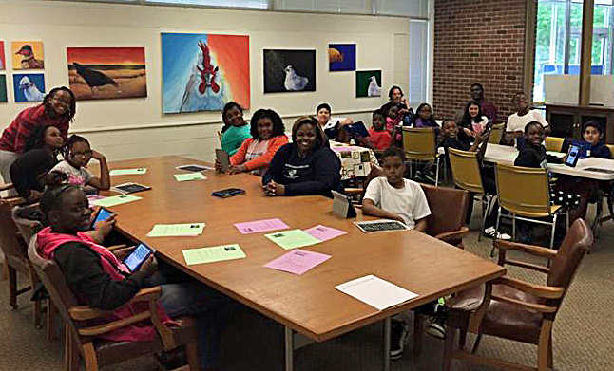
Community Group Served
Boys & Girls Club of Cherokee County
Mission statement: To inspire and enable all young people, especially those who need us most, to realize their full potential as productive, responsible, and caring citizens.
Four elementary schools feed into the B&G Club
Up to twenty 5th graders attend per visit

Slide 16
Purpose
According to the National Mentoring Partnership, about half of our youth population (that’s 18 million kids between the ages of 10 and 18) are considered “at risk.”
To foster educational curiosity in youth
To provide a positive learning experience using technology
To connect with the community

Slide 17
Promotion
Direct scheduling with the Club
Flyers used to recruit volunteers (students & faculty)
Announcements in faculty and division meetings
Email
Social media
Word of mouth

Slide 18
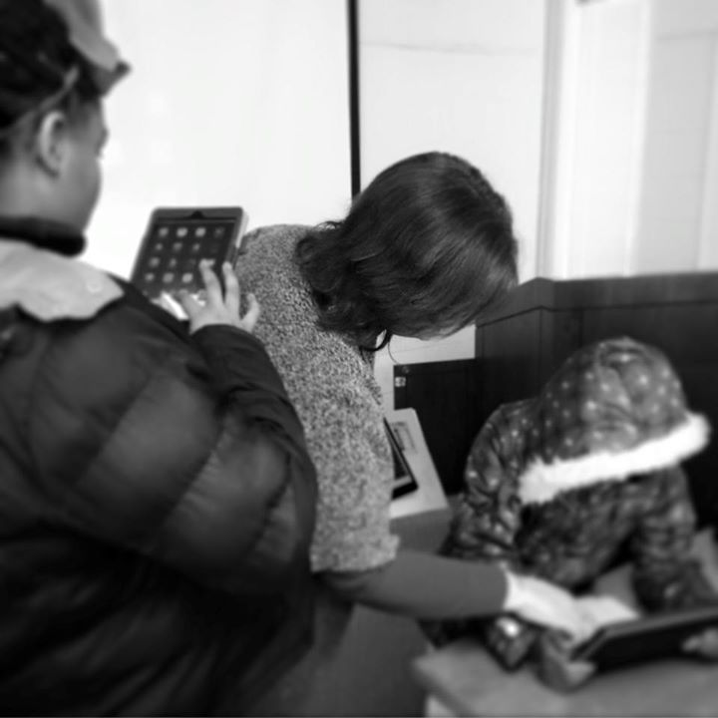
Topics
Slice It
Geoboard
Notes (for feedback)
Since students change each school year, the program format can stay the same.

Slide 19
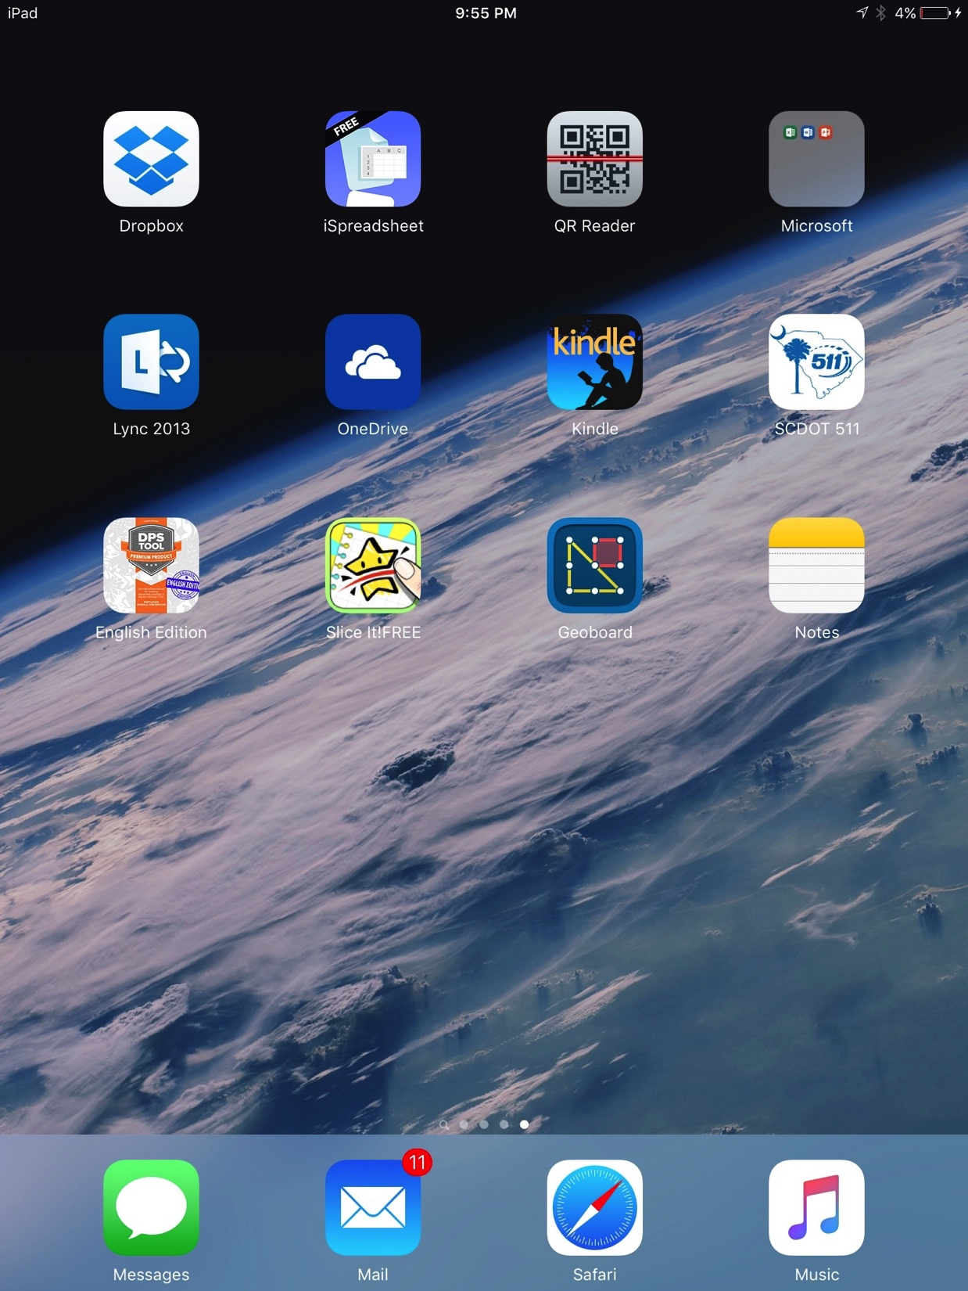
Topics

Slide 20
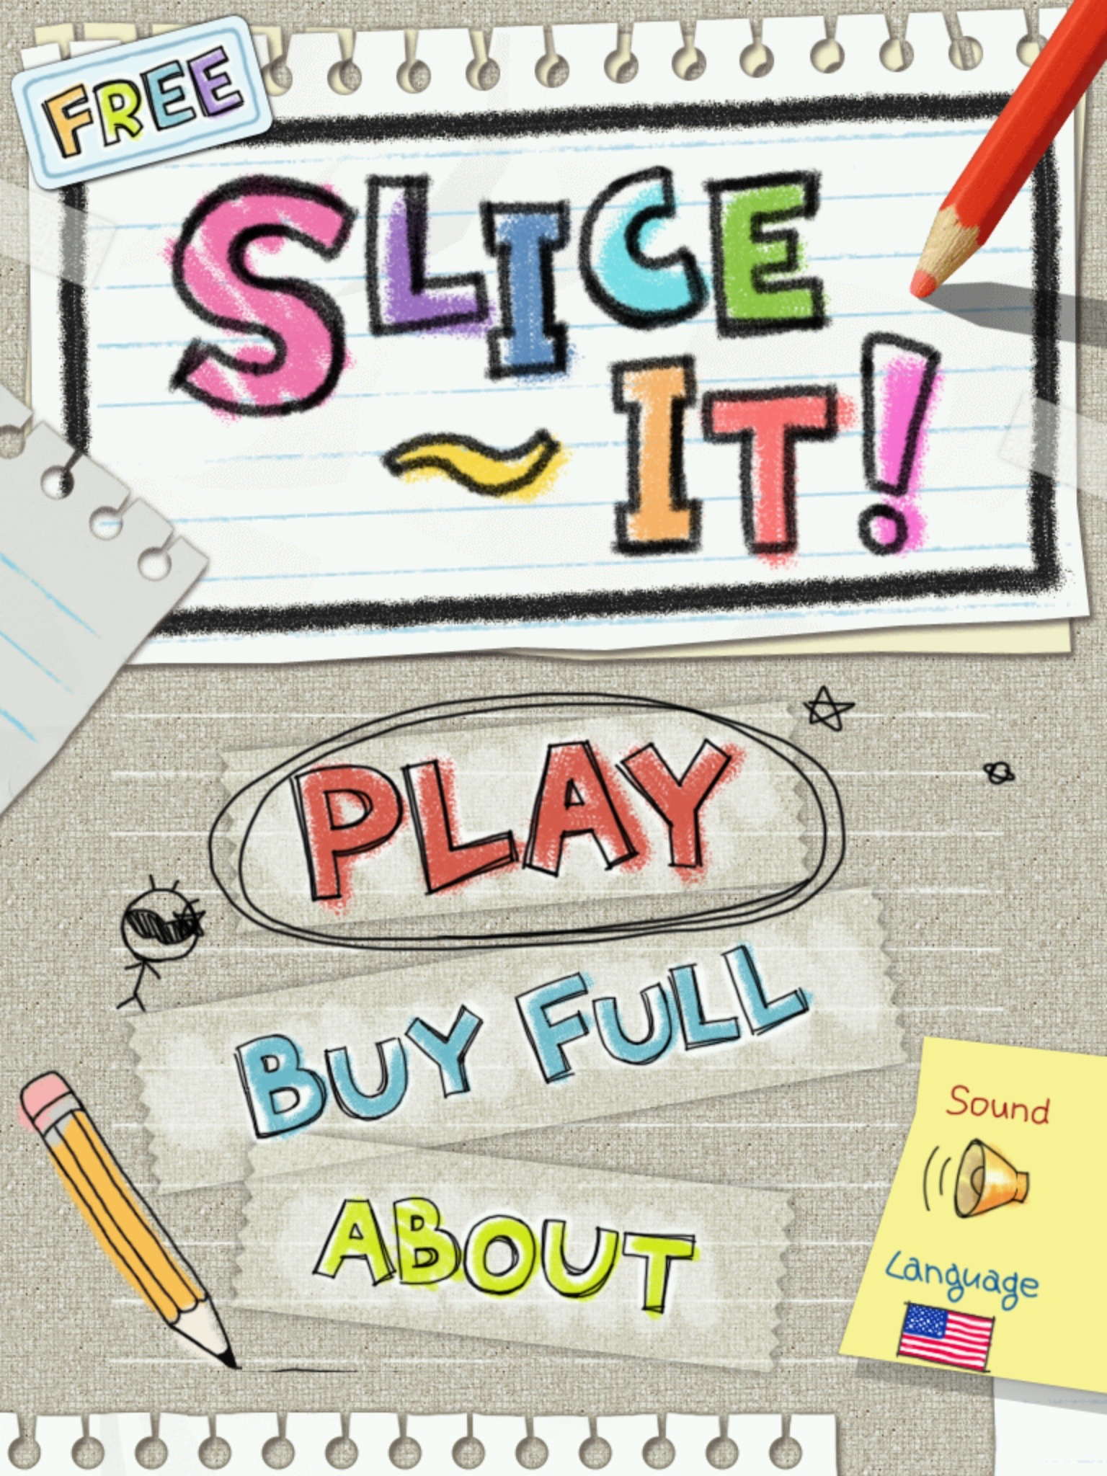
Slice It!

Slide 21
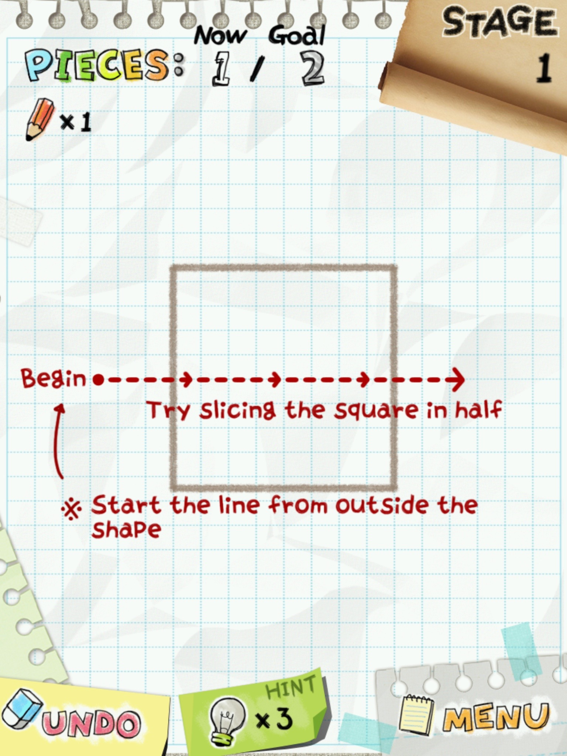
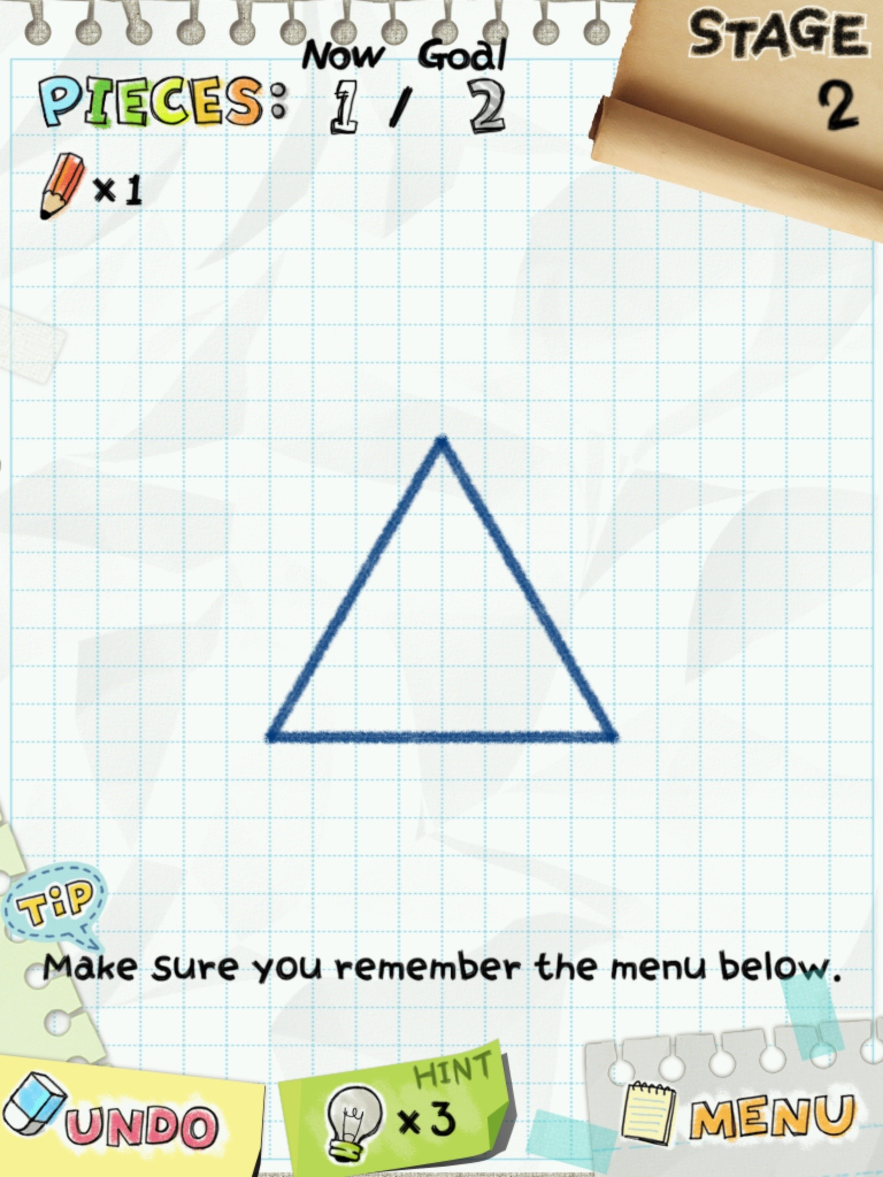

Slide 22
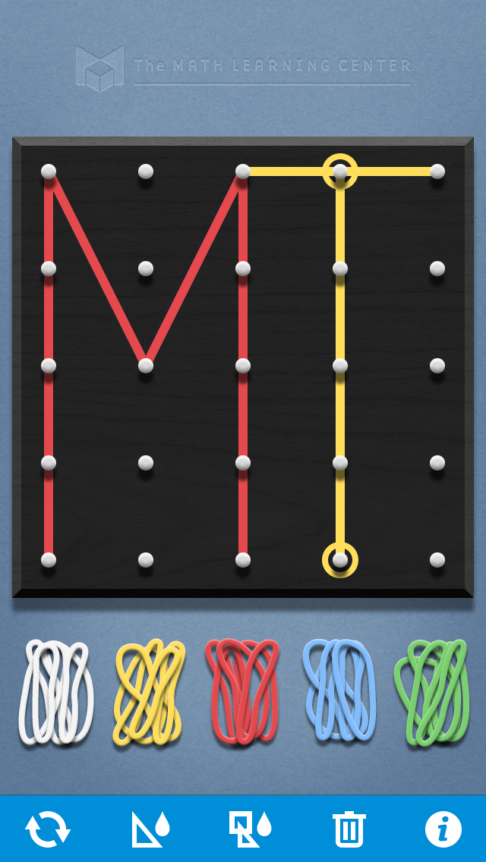
Geoboard

Slide 23
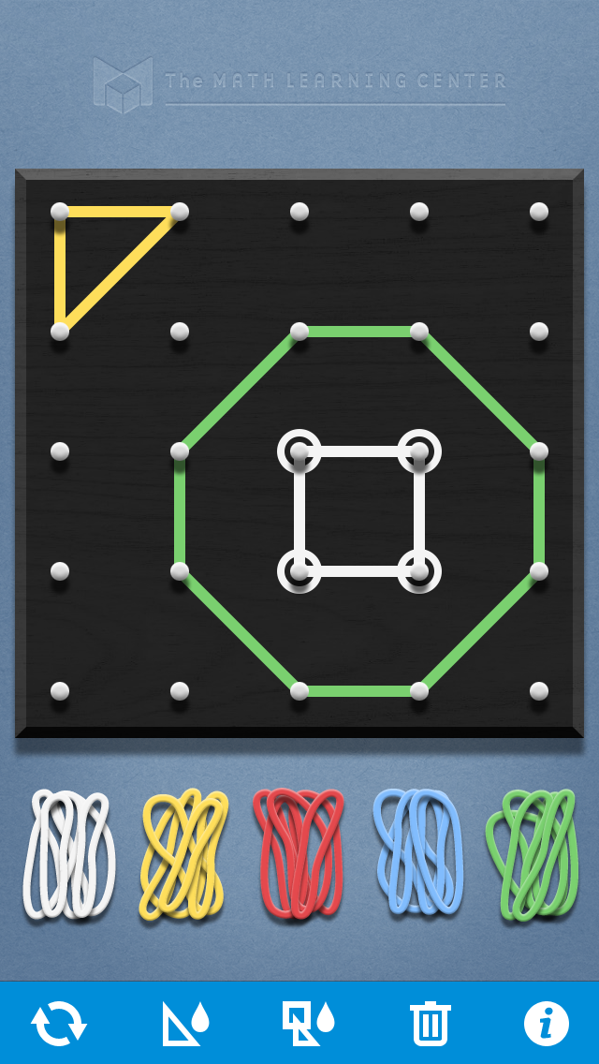
Geoboard

Slide 24
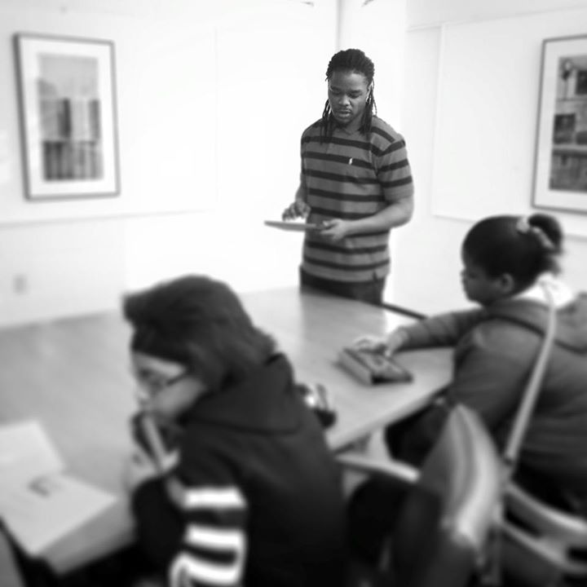
Planning & Expenses
One planning session before program launch
All volunteers
Bottled water provided
Printed instructions for apps and feedback

Slide 25
CHALLENGES
Dependable volunteers
Behavior management
Organization schedule

Slide 26
Feedback from students

Slide 27
Future of iPad Workshop
Continue program with 5th graders
Possible expansion to other grades
Requires more planning
Necessitates selecting new apps
Determining new ways to provide a positive, enjoyable event
Calls for more volunteers

Slide 28
Summary of Outreach Programs
Inexpensive
Productive
Encouraging
Relationship building
Minimal time investment outside of event

Slide 29
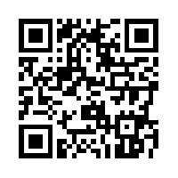
Contact Information
Susan Moore, Instruction Librarian/Archivist
smoore@limestone.edu
Janet Ward, Assistant Director/Web Services
jward@limestone.edu

